Slide 1
Calmer Classrooms - 3
The presentation and management of trauma in the classroom
Session 3:
Improving outcomes for students who have experienced trauma
Developing strategies for managing incidents with dysregulated students
Trauma is a sensitive topic
– be respectful of the impact which the session might have on other people

Slide 2
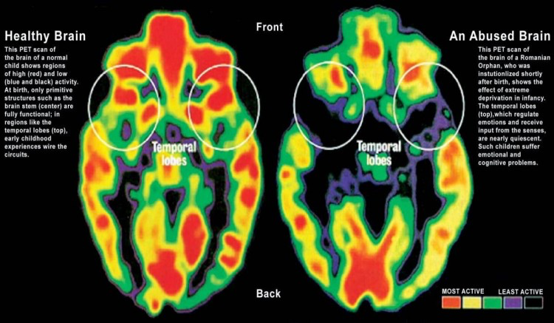
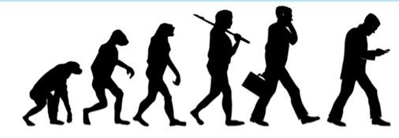
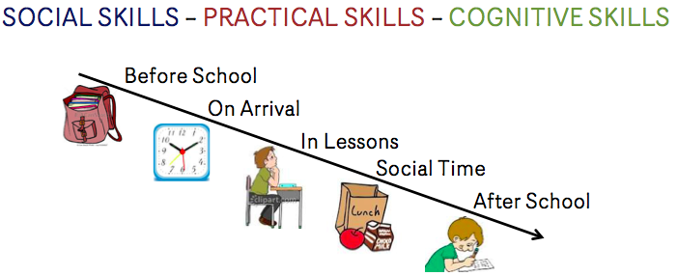
RECAP
Secure Attachment
CHRONIC and ACUTE Trauma Experiences
I am loved
I trust that my needs will be met
The world is a safe place
Negatively effects the developing brain
Behaviour is a language of communication
Emotional defence strategies
Impulsive responses to stress
Affect Dysregulation
Disassociation
Hyper-Arousal
School Challenges

Slide 3
Identifcation
If….....Behaviour is a Language of Communication:
How can you tell when it is an indicator of historic trauma experiences?
Can you know if a child’s dysregulated behaviour is linked to physiological or psychological impacts of trauma
What are the implications of this when we encounter dysregualted behaviour?
NEGLECT
& TRAUMA
DYSREGULATED
BEHAVIOURS
“Understanding the experience of the abused and neglected child assists us to develop compassion, patience and empathy.
It is a key intervention in itself” Calmer Classrooms (2007 )

Slide 4
Start with positive outcomes
You come across a student who is confrontational and distressed – what are the positive outcomes you can aim for?
De-escalate - minimise negative impacts
Prevent further traumatisation
Create a model for student to use in the future
Watch this
How is this relevant to the work we do with young people who have experienced trauma?
Re-secure attachment
Repair the physiological damage done to developing brains
Notes:
https://www.youtube.com/watch?v=CrZXz10FcVM
Gladys Wilson: 90yrs old-severe dementia (YouTube)
The need for connection is innate, even when almost all other faculties have gone - it remains within.
If dormant neurological processes can be reawakened in someone in the latter stages of Alzheimer's - it is equally possible in a young person impacted by trauma
This is achieved by demonstrating security; by synchronising, mirroring and reciprocating connection

Slide 5
Strategies: Part 1
Inter-Subjectivity of attachment
My experience of myself is reflected in how I perceive your experience of me
Behaviour is a 2-way Language of Communication
Dealing with dysregulated behaviour is distressing
What feelings can it prompt?
Your behaviour will be ‘read’ and ‘interpreted’ by a dysregulated student
What do you want it to say?
Self-protection: Defensive Relational Positions
It’s natural to take a defensive approach with a dysregulated student
What might this look like?
How would it be perceived by the student?
Mirroring: Reciprocating the relationship
Prioritising a students need to connect over your desire to protect promotes a reciprocal relationship
Affect Matching
The ability to demonstrate empathy by matching intensity and rhythm
but don't be ‘angry’
Notes:
To reciprocate in a relationship makes you vulnerable;
~ It exposes you to an implied or even overt challenge - "You are a terrible teacher"
~ Attempts we make to avoid this encourages us to take defensive relational positions
~ They protect you as an individual [Don't smile 'till Christmas - ‘It’s water of a ducks back’]
~ However this completely undermines the Inter-Subjectivity of your relationship and as such any opportunity for a YP to develop a Secure Attachment with you.

Slide 6
Strategies – Part 2
Immediate and Long-term goals:
De-escalate distress and Break-out of locked-in cycle
Promote secure attachments
PACE ~ Practical interventions to help teachers to find routes of engagement
Playfulness ~ Present yourself as light, hopeful, open, spontaneous.
For a student with Insecure Attachments this is a more acceptable and unthreatening form of affection.
Learning to accept and enjoy affection is an essential stage in re-learning ‘attachment’
Acceptance ~ Direct your attention unconditionally at the experience of a student
Be interested in everything they have to say - without evaluating it.
Permit them to express their motivations for behaviours – This is not giving permission for the behaviour
To understand why a student acts in a certain way you need to know how they feel before during and after their action.
A student will be more likely to tell you what they actually feel, if they believe that you are not evaluating or judging them.
Curiosity ~ Demonstrate a non-judgmental and active interest in a student
Express your desire to understand their actions, rather than fix the person.
When you are being curious you can wonder out-loud - Articulate possibilities, causes, feelings - and wait for connection
Empathy ~ Articulate the feelings you sense from the student
You might express these feelings verbally or non-verbally
Empathising with a YP who is holding onto emotions like fear, sadness, shame can make you feel distressed or sad.
If a student knows you can hold onto their sadness, shame or anger, it protects them and models a route to recovery
How could these strategies be employed “in the moment” of an incident or “longer-term “as part on attatchment repair”?
Think about; Accessible Language and Practical Actions

Slide 7
What next….....
Compassion Focused Practice
Sensitivity to suffering and distress with a deep commitment to relieve and prevent it
Compassion as;
A Positive – kindness and empathy, rather than Negative - soft and weak
An integrated function of mind – rooted in clear understanding of the brain
A healing function of mind – built uponthe brains capacity to be transformed
Miller Williams
Have compassion for everyone you meet
Even if they don't want it.
What seems conceit, bad manners, or cynicism
Is always a sign of things
No ears have heard and no eyes have seen.
You do not know what wars are going on down there
Where the spirit meets the bone.

Slide 8
Strategies for managing students with dysregulated behaviours
CONCLUSIONS
Behaviour is a Language of Communication:
Dysregulated behaviours maybe an indicator of acute or chronic trauma and neglect
The message behind all dysregulated behaviour should be considered without presumption
Behaviour is a 2-way Language of Communication
Dealing with dysregulated behaviour is distressing and it will effect you
What do you want your behaviour to say?
PACE: Interventions with Immediate and Long-term goals:
Playful – Accepting – Curious - Empathy
De-escalate distress and Break-out of a locked-in cycle
Promote secure attachments
Supporting each other:
Offering support to colleagues can help them step out of a confrontation cycle
Accepting support from colleagues helps you maintain emotional control and communicate positively

Slide 9
How could these strategies be employed?
“in the moment” to de-escalate an incident
“longer-term“ as part on attatchment repair”?
Think about; Verbal and Non-verbal interaction
 | In the moment | Longer-term
Playful
Accepting
Curious
Empathy

Slide 10
Adult Response Checklist
In a crisis situation-
Check your emotions
Body language is non confrontational
Voice is low and slow
Words are minimal and instructional
The student or the trigger removed
Adequate recovery time before reflection (30mins+)
Opportunity for reflection with student
Opportunity to reflection with colleagues
Incident is recorded and key adult/s informed

