Slide 1
GCSE Results 2017
The Headlines

Slide 2
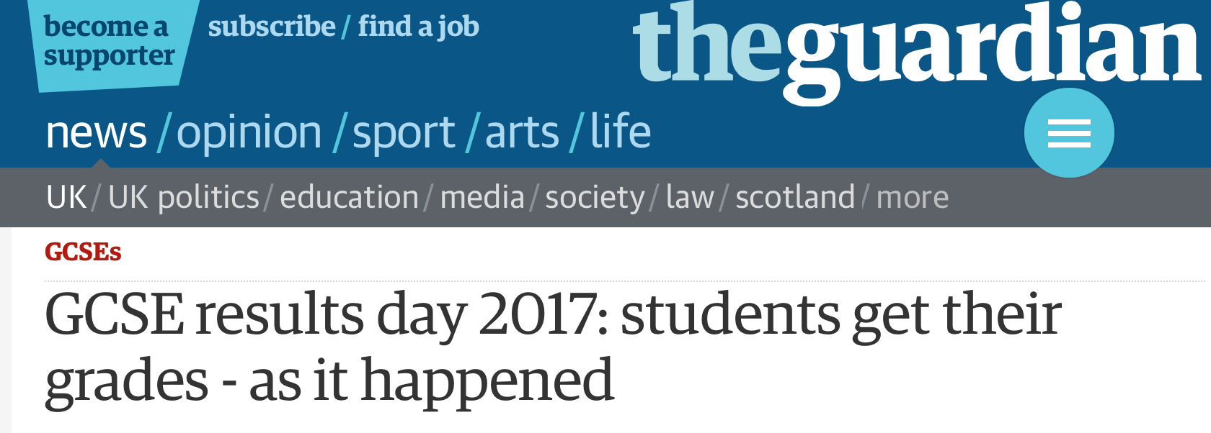
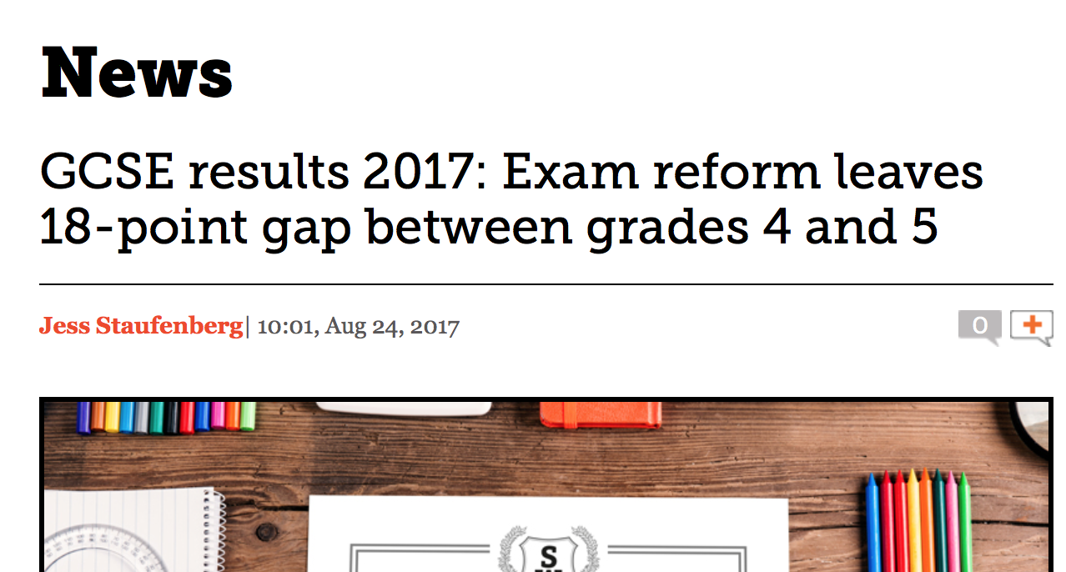
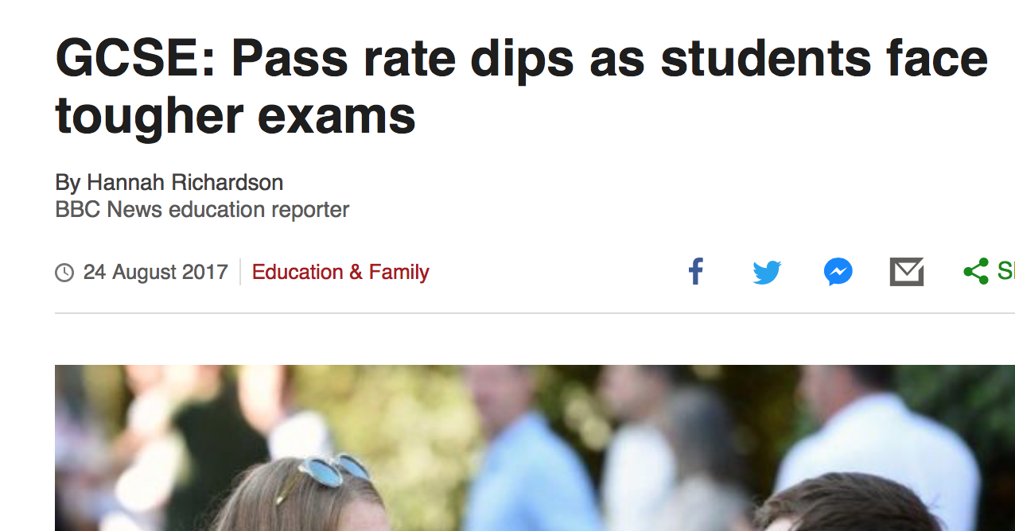
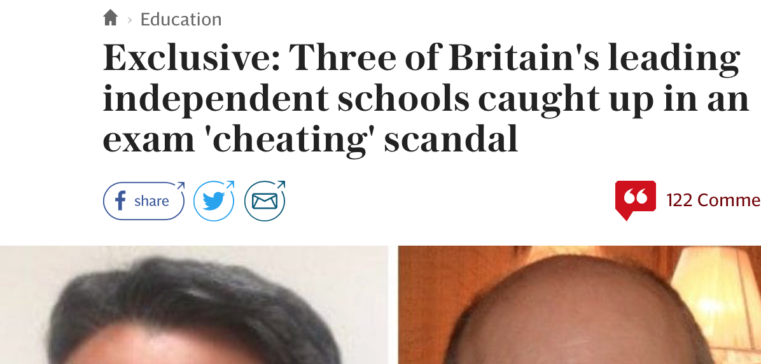
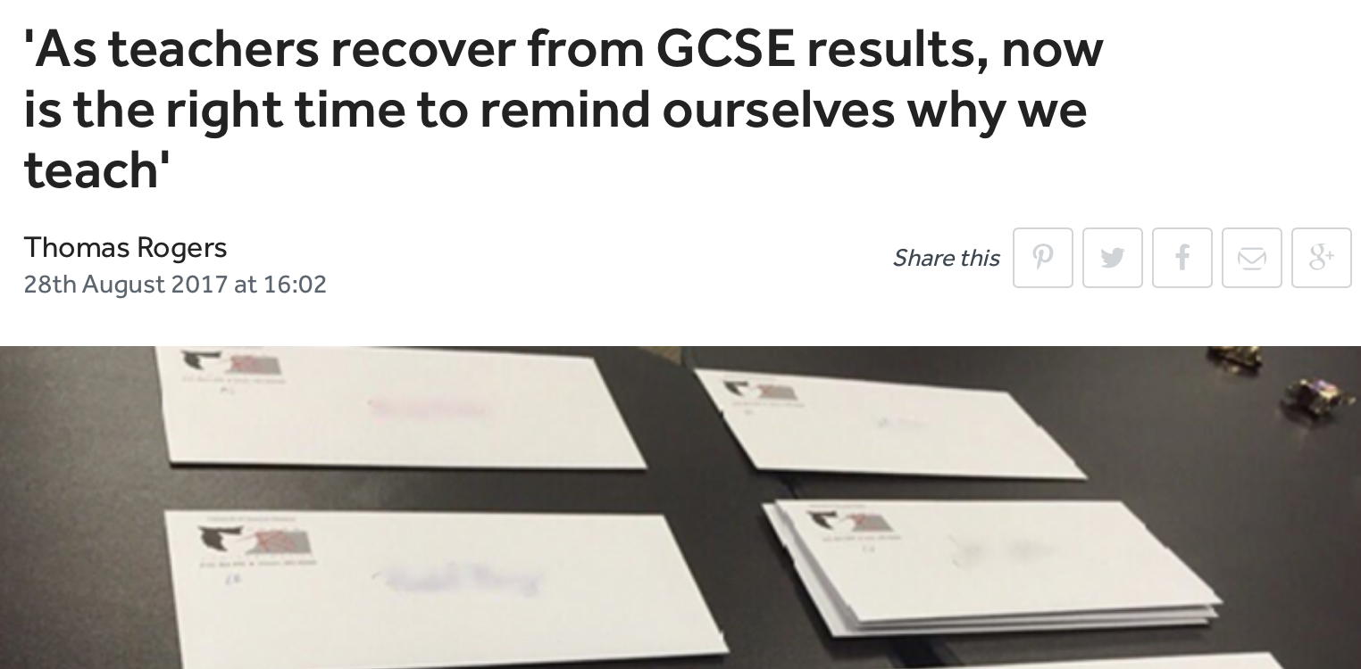
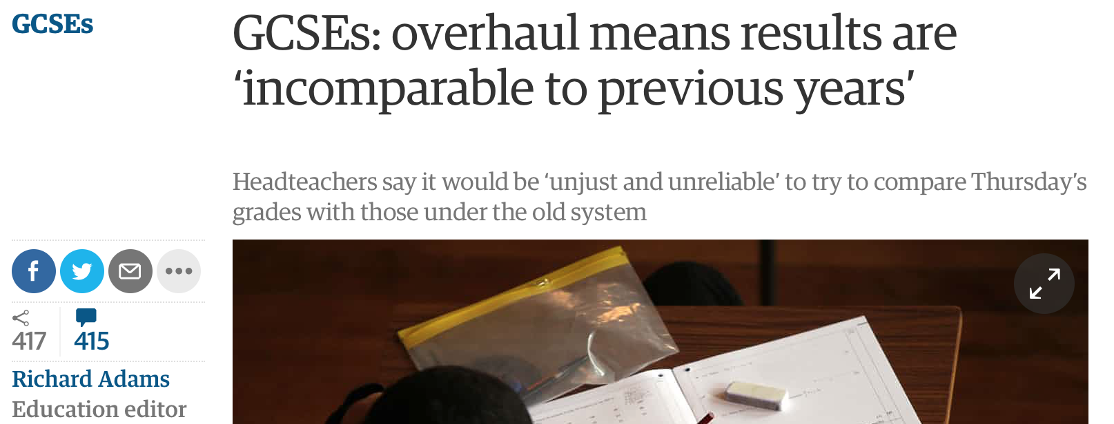
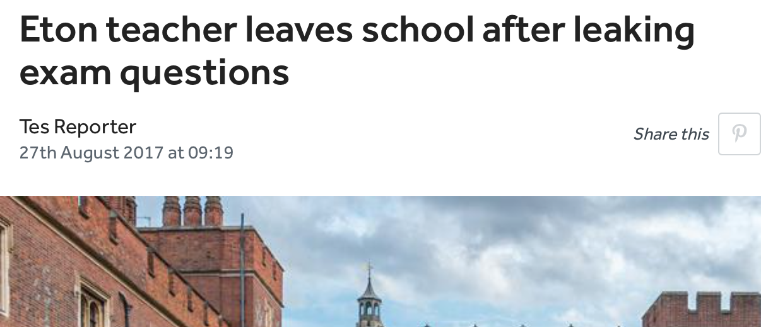
GCSE results 2017

Slide 3
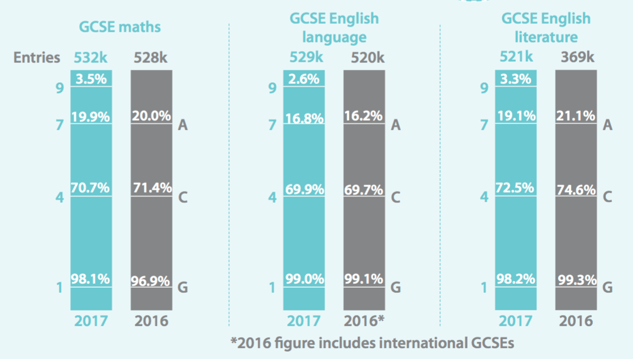
The National Picture 2017
Body text here...

Slide 4
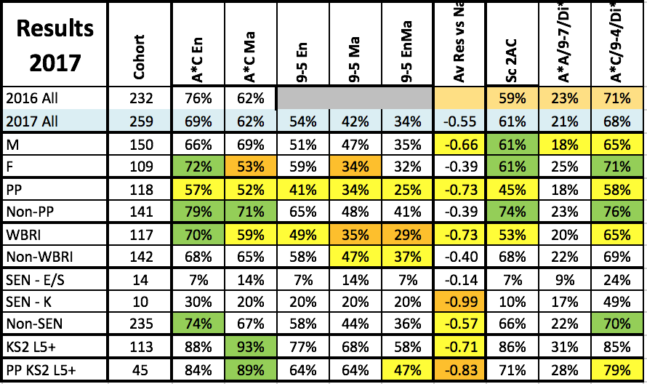
2017 GCSE Main Headlines
* Highlighted orange as headline measures
Positives
Better than 2014/5 with largest ever cohort
Improved A8 score
Improved 2AC science
Maintained MFL
23 students with 7 or more A*/A/7-9
Negatives
Lower EnMa results at 4 (particularly En)
More able year group, so expecting much lower P8
Lower Hums
Lower Ebacc
Lower A*/A (remains a key target for school)

Slide 5
2017 GCSE Group Headlines
Areas of focus
Girls /white British numeracy
Pupil Premium progress
Boys and progress
White British progress
L5+ (particularly PP)

Slide 6
2017 GCSE Subject Headlines
2017 Positives
Science
Art
Food tech
Product design
Photography
Dance
Music Btec
Art & Design Btec
Care Btec
Areas of 2017 concern
Maths
English
History
Geography
Computing
French
Graphics
RE
Media
Drama
PE
Business
Areas of repeat concern
Maths
Graphics
RE
Media
PE
Business

Slide 7
2017-18 GCSE Key Targets
Pupil premium
High achievers (L5+)
Boundary leapers (3s to 4s, 4s to 5s and 6s to 7s)
Girls and numeracy
Boys progress
White British progress
AND…
Where these meet.

Slide 8
How? Engagement, Understanding, Preparation, Intervention
Engaging the students; teaching to enthuse and inspire – over to you!
Engaging parents – all of us.
Linearity – get them prepared!
Knowing the new specs…we have to do whatever we can.
Being on top of the data for groups and individuals – all of us.
Re focus Raps – watch this space

