Slide 1
Lesson 3 – Experiencing God
Wednesday, 9 January 2013
Los
To describe and explain the different ways religious believers experience God.
To evaluate how these may affect follows of these religions.

Slide 2
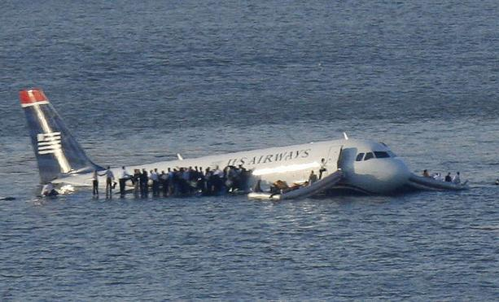
Look at the miracle sheet
Which ones of these are miracle?
Tick or cross.
Be ready to share your views.

Slide 3
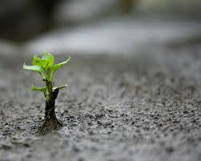
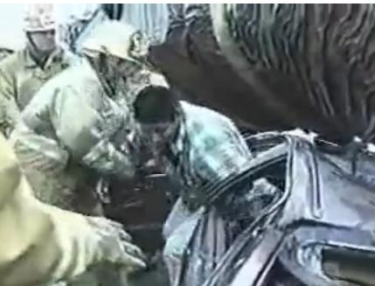
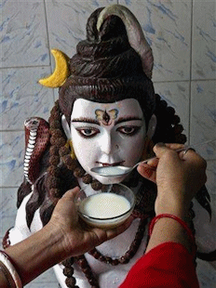
Stand up sit down
As we read through the miracles
Stand up if you think it’s a miracle – but be ready to explain your answer!

Slide 4
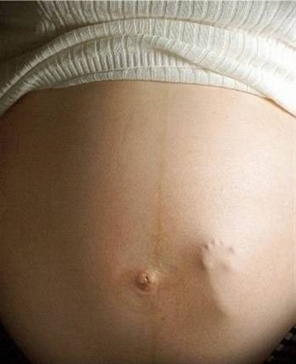
Watch and Think
What are miracles?
Can you think of an example?

Slide 5
Watch and Answer

Slide 6
Quick exam practice
‘Miracles are a good reason to be religious.’
Give two reasons why a religious believer may agree or disagree with this statement. Explain two points of view, giving appropriate examples.

Slide 7
Miracles are a good reason to be religious.
What might a religious believer say?
A D grade answer will give a simple explanation, with one short example.
A C grade answer will add more detail, explaining why miracles can be important in religion, adding at least one example.
A B grade answer will give a detailed explanation of what a miracle is, and why they are important to religious believers, with at least two examples.
An A grade answer will consider both sides of the argument, using examples for each side, and reaching a balanced conclusion.

Slide 8
And Finally…
Peer mark your partners work using
A D grade answer will give a simple explanation, with one short example.
A C grade answer will add more detail, explaining why miracles can be important in religion, adding at least one example.
A B grade answer will give a detailed explanation of what a miracle is, and why they are important to religious believers, with at least two examples.
An A grade answer will consider both sides of the argument, using examples for each side, and reaching a balanced conclusion.

Slide 9
Are these miracles?
Having a baby?
Something beautiful in the natural world?
A man living in a country where AIDS is common being diagnosed with HIV and then getting better?
Surviving a life threatening illness and dangerous surgery?
A man and his daughter both reporting a statue in their garden crying real tears?
Getting a job you wanted over 1,880 other applicants?
Winning the National Lottery?
A severely disabled woman getting better after being washed in pools of water at a Catholic shrine?
A statue in a Hindu mandir is reported to drink milk?
Surviving a 100m fall while climbing?
Being saved from a collapsed building after an earthquake 7 days before?
Marrying the person of your dreams?
Having a vision of God?
God creating the world?
Are these miracles?
Having a baby?
Something beautiful in the natural world?
A man living in a country where AIDS is common being diagnosed with HIV and then getting better?
Surviving a life threatening illness and dangerous surgery?
A man and his daughter both reporting a statue in their garden crying real tears?
Getting a job you wanted over 1,880 other applicants?
Winning the National Lottery?
A severely disabled woman getting better after being washed in pools of water at a Catholic shrine?
A statue in a Hindu mandir is reported to drink milk?
Surviving a 100m fall while climbing?
Being saved from a collapsed building after an earthquake 7 days before?
Marrying the person of your dreams?
Having a vision of God?
God creating the world?

Slide 10
Video Question Sheet
What is a pilgrimage?
_________________________________________________
.Give two examples of places Christians may visit on a pilgrimage.
_________________________________________________
_________________________________________________
Why do people visit Lourdes.
_________________________________________________
_________________________________________________
Can you give an example of a pilgrimage made by people of another faith?
_________________________________________________
_________________________________________________
Keywords: Revelation and Awe.
_________________________________________________
_________________________________________________
Answer question on PowerPoint and use mark scheme,
_________________________________________________
_________________________________________________
Video Question Sheet
What is a pilgrimage?
_________________________________________________
.Give two examples of places Christians may visit on a pilgrimage.
_________________________________________________
_________________________________________________
Why do people visit Lourdes.
_________________________________________________
_________________________________________________
Can you give an example of a pilgrimage made by people of another faith?
_________________________________________________
_________________________________________________
Keywords: Revelation and Awe.
_________________________________________________
_________________________________________________
Answer question on PowerPoint and use mark scheme,
_________________________________________________
_________________________________________________

