Slide 1
Tallis Inclusion Framework
Support for students with high needs
Support for students with identified needs
Support for ALL students

Slide 2
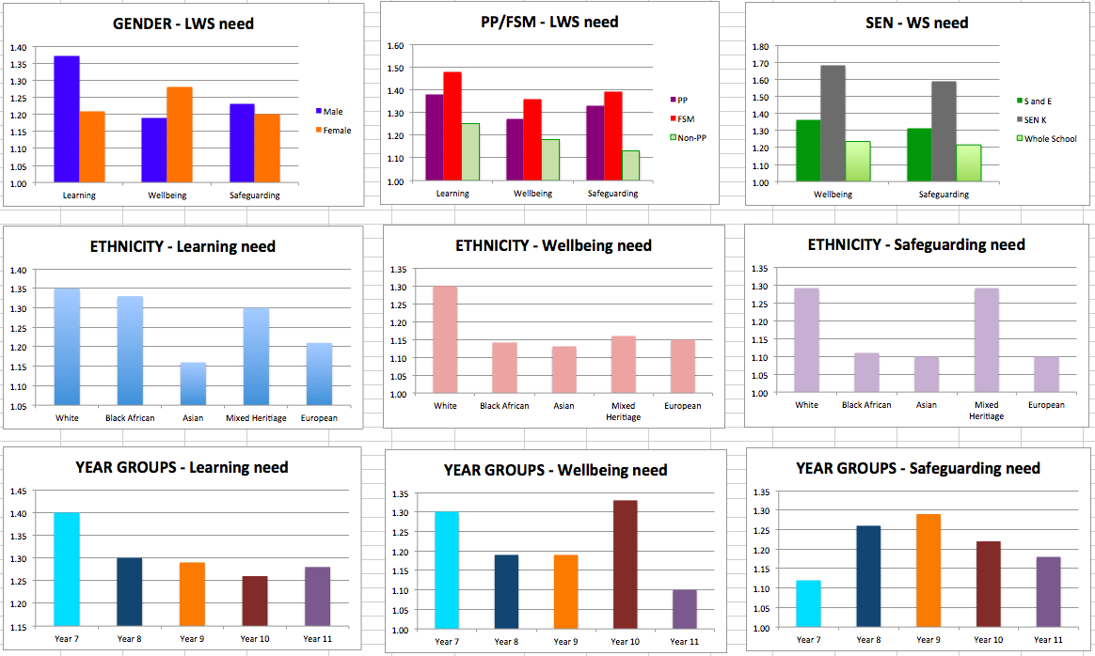
Tallis Inclusion Need – July 2017
Wellbeing Score in April

Slide 3
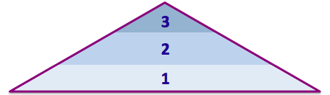
Tallis Inclusion – This Year
Safeguarding
Well-being
3
2
1
3 - High Needs
2 - Identified Needs
1 - All Students
Learning

