Slide 1
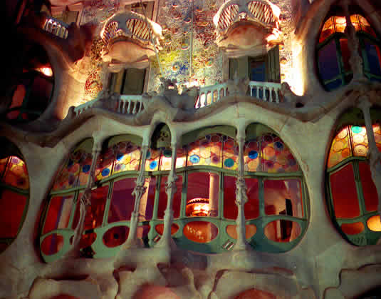
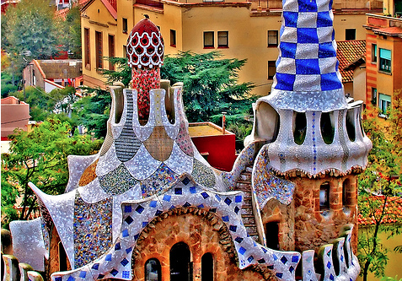
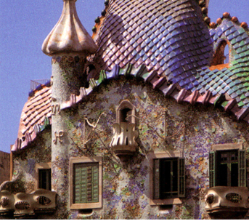
5 min Starter (As soon as you see this start)
Title = Gaudi’s buildings
In your books or on paper provided
what type of natural forms can you see in Gaudi’s building?
What colours represent what from nature?

Slide 2
Homework
Refine and add detail to your natural form inspired building/home Add Line Shape Detail Tone Form and Texture
Create the landscape around your building/home.

Slide 3
Lesson Focus: Making and communication
AF3
Home School objective: Exploring organic (natural) forms to design your own Gaudi inspired home key words Shape, Tone, Texture and Form
Using natural forms from home such as Vegetables, fruits, plants, flowers, trees etc Create a design of a home made out of different natural forms inspired by Antoni Gaudi. Please look at all the visuals to help and support your designs and ideas.
Lesson outcomes
Level 3 and below
All: I have copied a natural forms in detail
Level 4
Most: I have copied a natural forms in detail and incorporated them in my building design
Level 5 and above Some: I have copied natural forms in detail and incorporated them in my building design using refined skills and can justify the relevance to Gaudi and natural form.
.

Slide 4
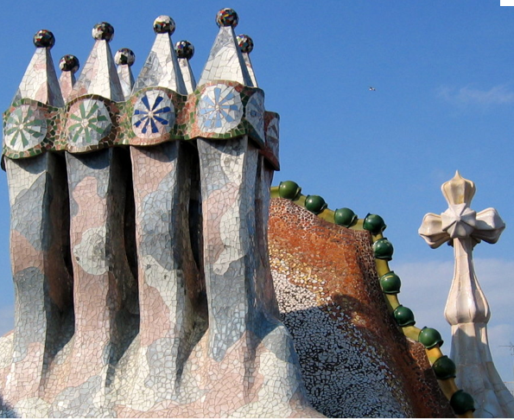
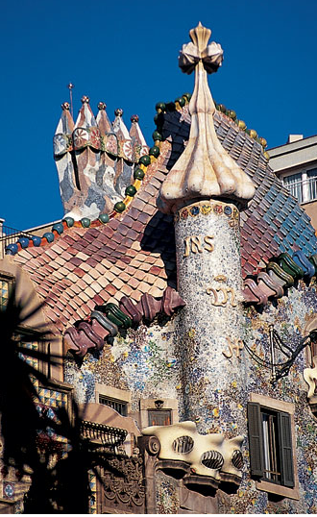
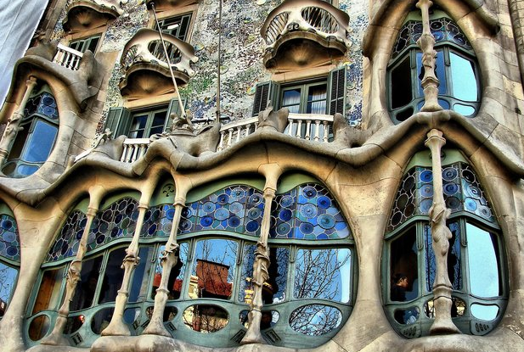
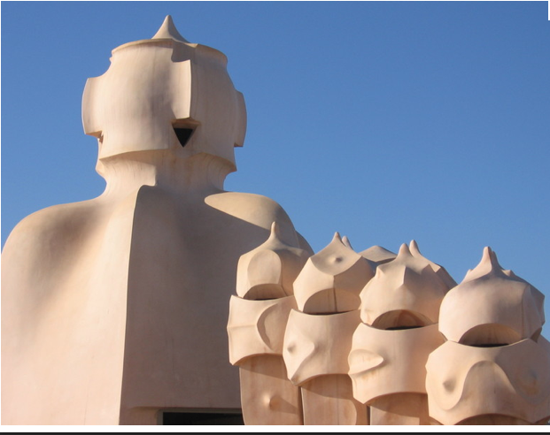

Slide 5
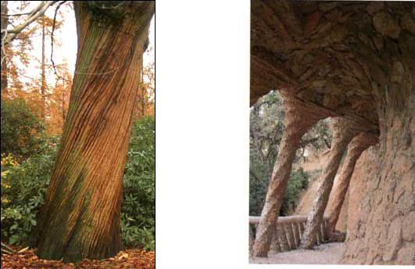
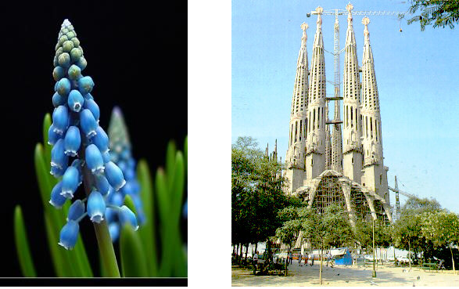
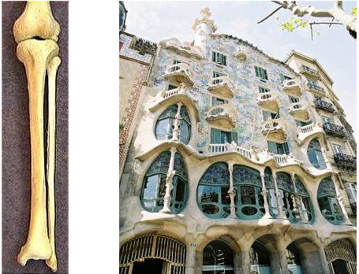
The Artist Hundertwasser was inspired by Gaudi’S use of natural forms

Slide 6
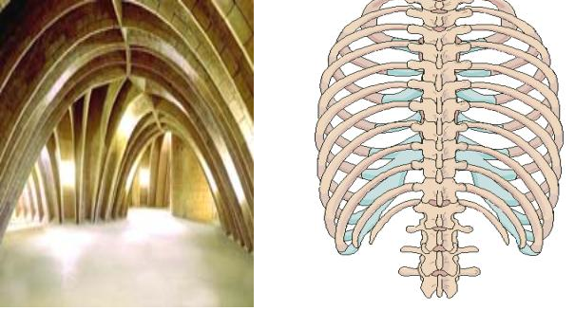

Slide 7
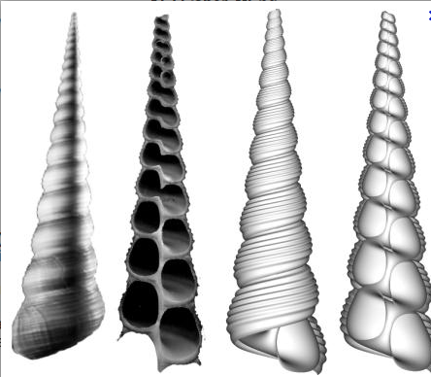
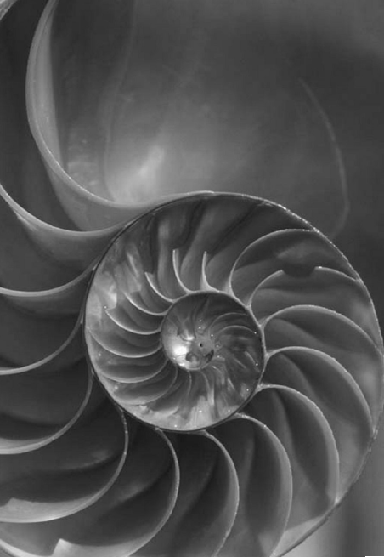
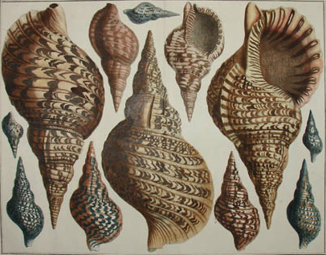
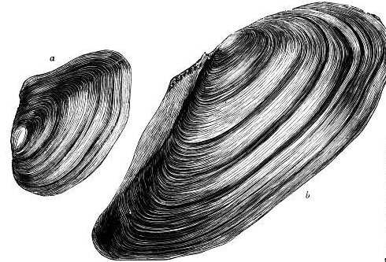

Slide 8
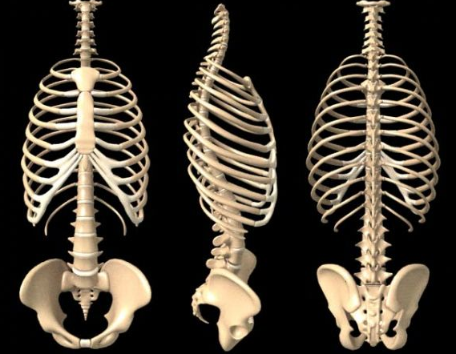
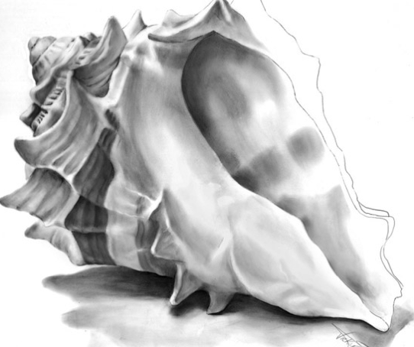
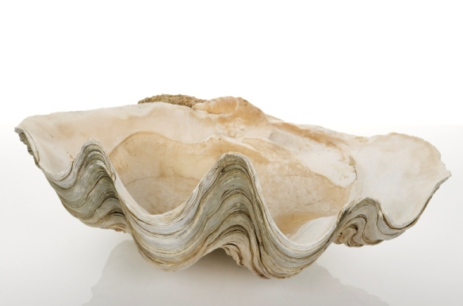

Slide 9
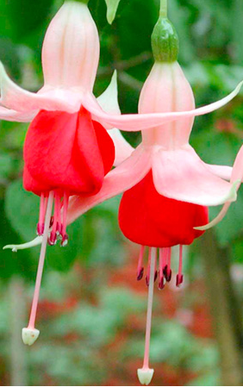
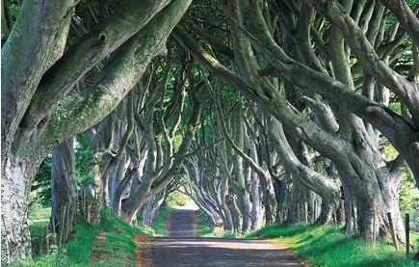
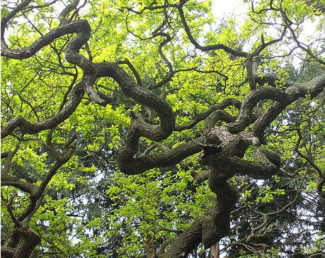
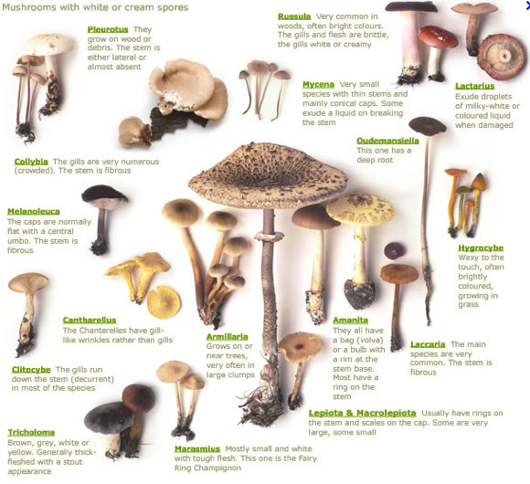
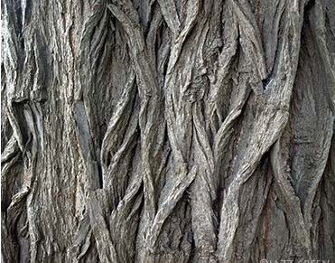

Slide 10
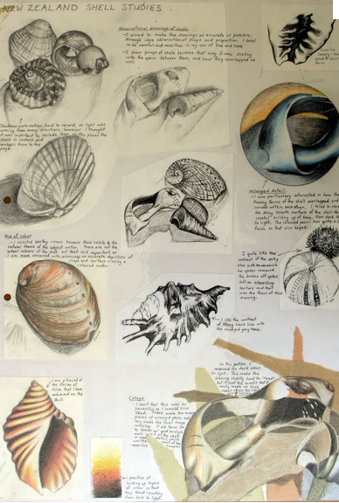
Drawings of natural forms

Slide 11
The snail house drawings

Slide 12
The snail house building

Slide 13
